Slide 1

Client Behaviour Classification in Banking
Project Title: Client Behavior Classification in Banking
Presented By: Chandana S.
College Name: BMS College for Women
Department: Information Technology
Email ID: your.email@example.com
AICTE Student ID: 1234567890
Presented By : Chandana S
Student Name: Chandana S
College Name: Manipal university jaipur
Department: computer science
Email ID: schandana2010@gmail.com
AICTE Student ID: STU65b509efc5b311706363375

Slide 2
Outline
• Problem Statement
• Proposed System/Solution
• System Development Approach
• Algorithm & Deployment
• Result
• Conclusion
• Future Scope
• References
Problem Statement
Proposed System/Solution
System Development Approach
Algorithm & Deployment
Result (Output Image)
Conclusion
Future Scope
References

Slide 3
Problem Statement
Banks often struggle to identify which clients are likely to subscribe to term deposit offers. Making accurate predictions using customer demographic and behavioral data is a major challenge. Misclassification can lead to missed marketing opportunities or wasted resources.
Banks often struggle to identify which clients are likely to subscribe to term deposit offers. Making accurate predictions using customer demographic and behavioral data is a major challenge. Misclassification can lead to missed marketing opportunities or wasted resources.

Slide 4
Proposed Solution
We propose a machine learning-based classification model that can predict whether a client will subscribe to a term deposit offer. The system will:
• Preprocess and transform client data
• Select the most relevant features
• Train classification models (Decision Tree, Extra Trees, Logistic Regression)
• Evaluate and visualize model performance for better decision-making
Banks often struggle to identify which clients are likely to subscribe to term deposit offers. Making accurate predictions using customer demographic and behavioral data is a major challenge. Misclassification can lead to missed marketing opportunities or wasted resources.
Preprocess and transform client data : Preprocess data by encoding categorical values and normalizing numeric features.
Select the most relevant features: Select important features using statistical and model-based methods (e.g., Chi2, Mutual Info, Extra Trees)
Train classification models (Decision Tree, Extra Trees, Logistic Regression) : Train models like:
Decision Tree (for interpretability)
Extra Trees (for high accuracy)
Logistic Regression (as baseline)
Evaluate and visualize model performance for better decision-making : Evaluate models using accuracy score and confusion matrix

Slide 5
System Development Approach
Libraries Used:
- pandas, numpy, matplotlib, seaborn
- sklearn: preprocessing, model selection, classifiers, metrics
- graphviz: decision tree visualization
System Steps:
- Data preprocessing (encoding + normalization)
- Feature selection (chi2, mutual_info, ExtraTrees)
- Model training (Scikit-learn)
- Tree visualization
Libraries Used:
pandas, numpy, matplotlib, seaborn
sklearn: preprocessing, model selection, classifiers, metrics
graphviz: decision tree visualization
System Steps:
Data preprocessing (encoding + normalization)
Feature selection (chi2, mutual_info, ExtraTrees)
Model training (using Scikit-learn)
Tree visualization

Slide 6
Algorithm & Deployment
Algorithms Used:
- ExtraTreesClassifier for feature importance and classification
- LogisticRegression for baseline classification
- DecisionTreeClassifier for interpretability
Input Data:
- Categorical & numerical client features
Deployment:
- Models trained using train_test_split
- Accuracy measured using accuracy_score
- Tree visualized using Graphviz
Algorithms Used:
ExtraTreesClassifier: for feature importance and classification
LogisticRegression: baseline classification
DecisionTreeClassifier: for model interpretability
Input Data:
Categorical features (job, marital, education, etc.)
Numerical features (age, campaign, duration, etc.)
Deployment:
Model trained using train_test_split
Accuracy evaluated using accuracy_score
Tree visualized using plot_tree

Slide 7
Result
Accuracy Scores:
- Extra Trees Classifier: ~90%
- Logistic Regression: ~89–90%
- Decision Tree: ~87%
Top Features: duration, euribor3m, age, cons.price.idx
(Insert decision tree image from graphviz here)
Accuracy Scores:
Extra Trees Classifier: ~90%
Logistic Regression: ~89–90%
Decision Tree: ~87%
Top Features Identified:
duration, euribor3m, age, cons.price.idx, etc.

Slide 8
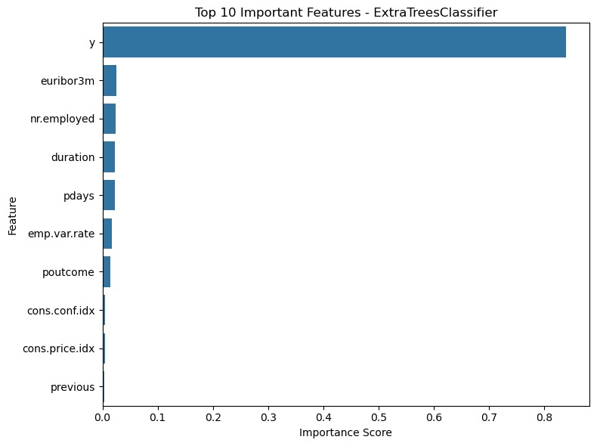
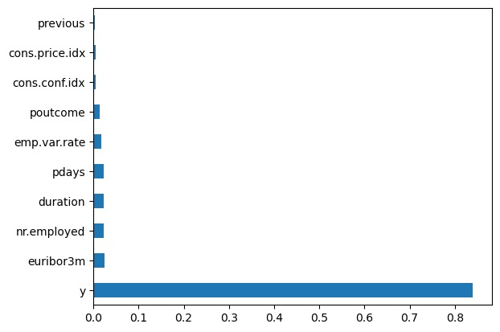
Output

Slide 9
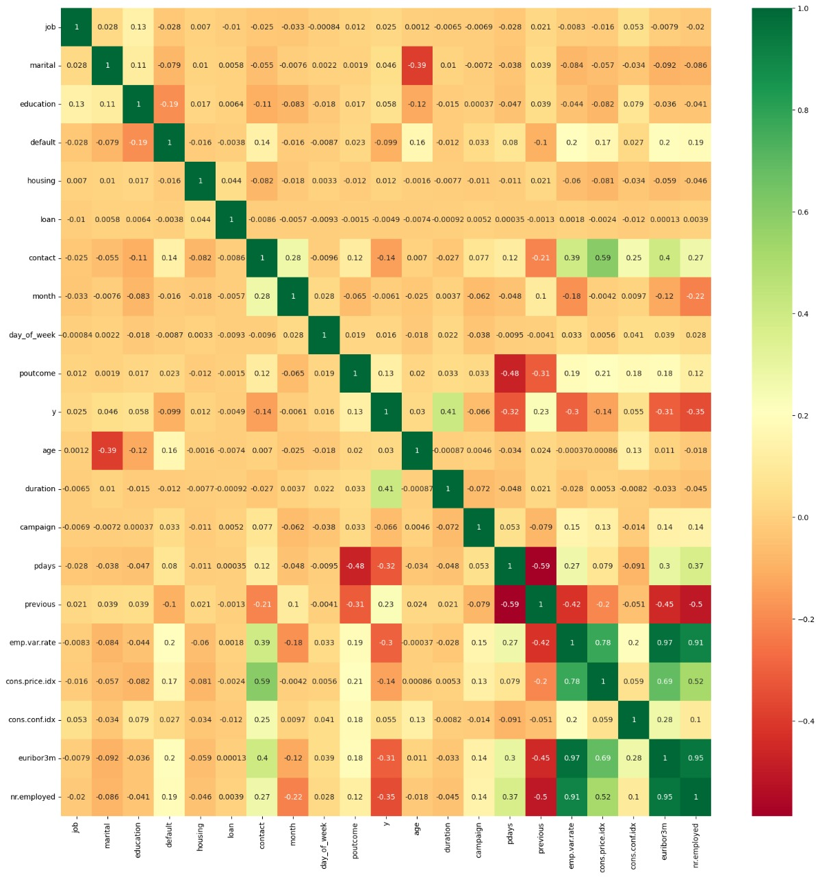

Slide 10
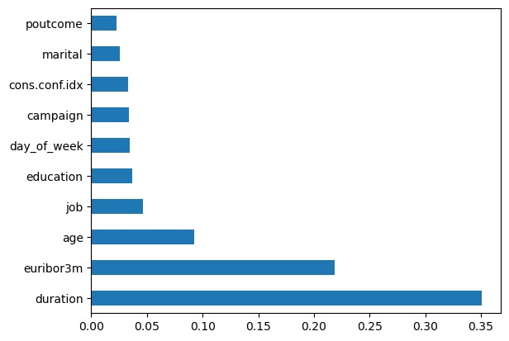
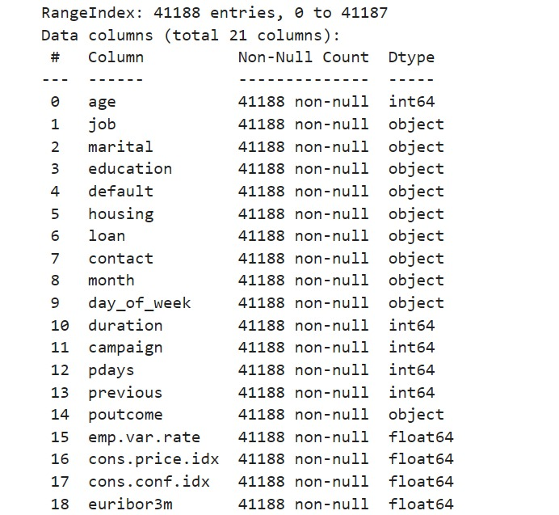
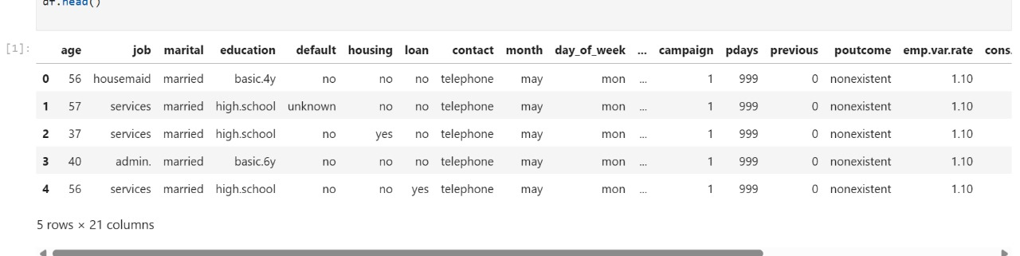

Slide 11
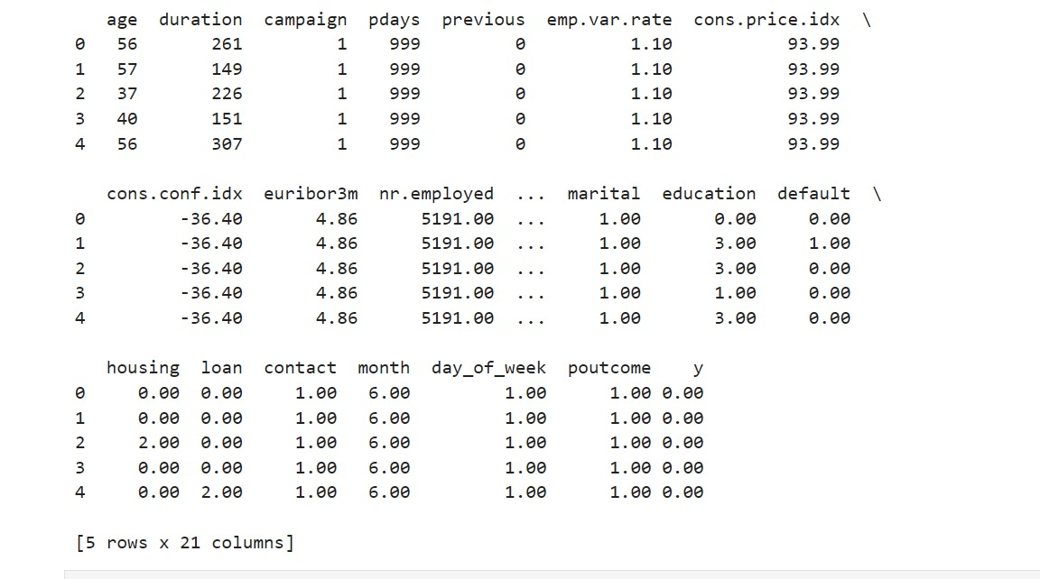
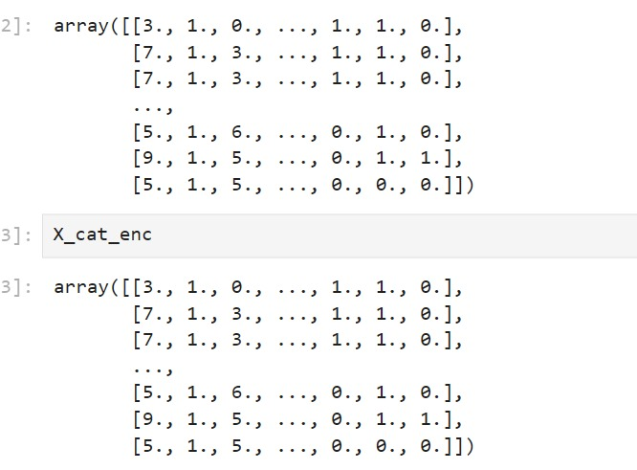
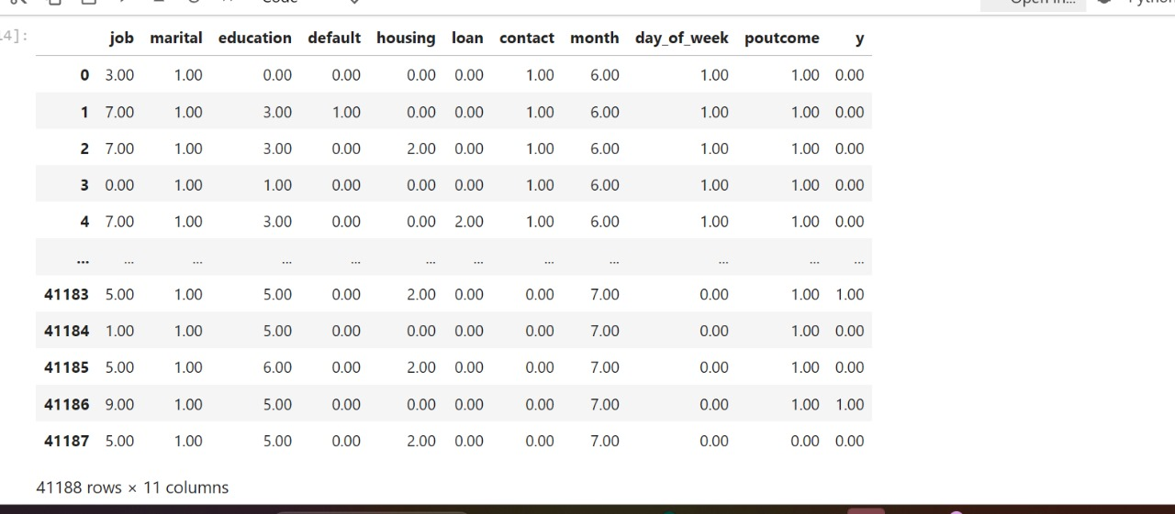
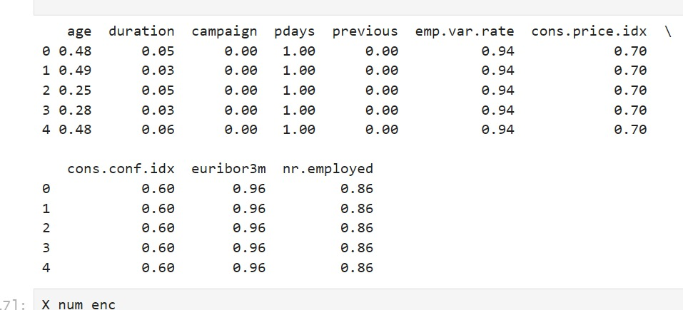

Slide 12
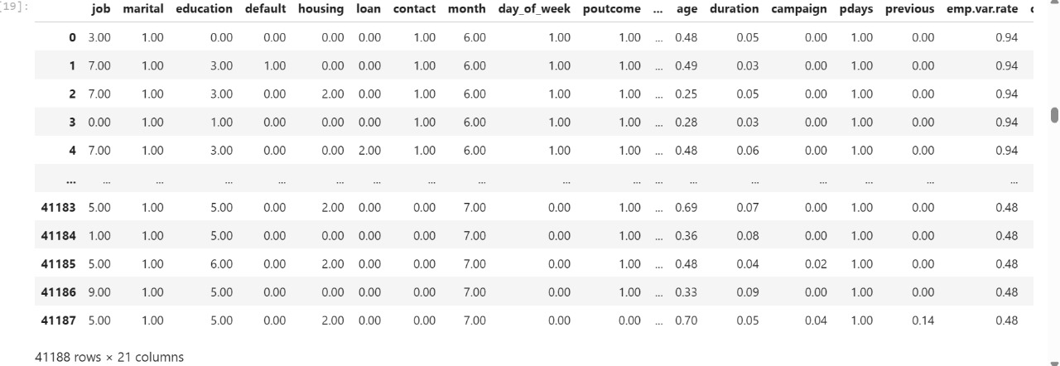
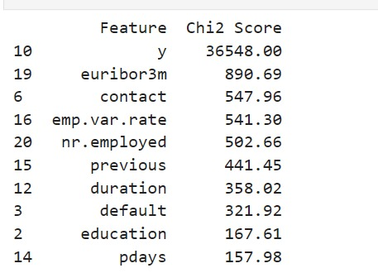
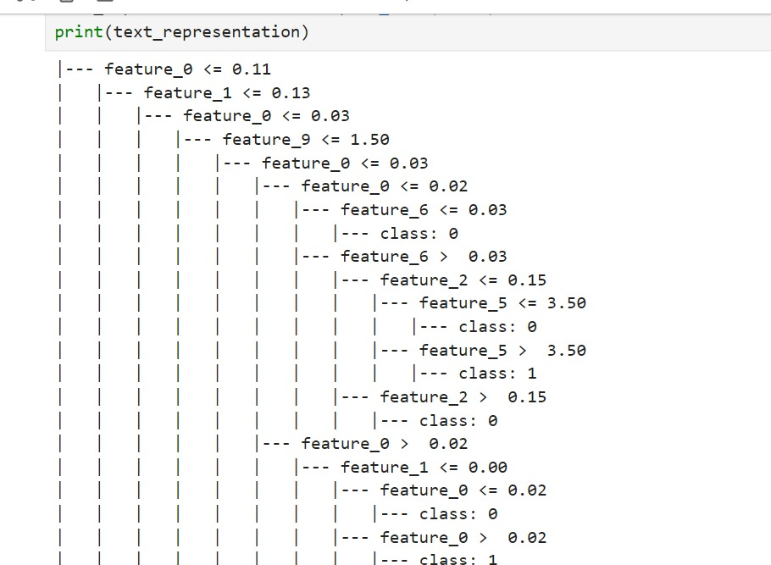
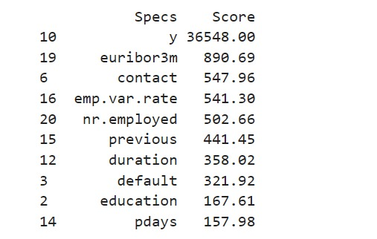

Slide 13
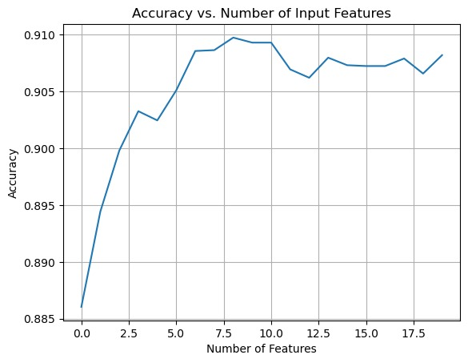
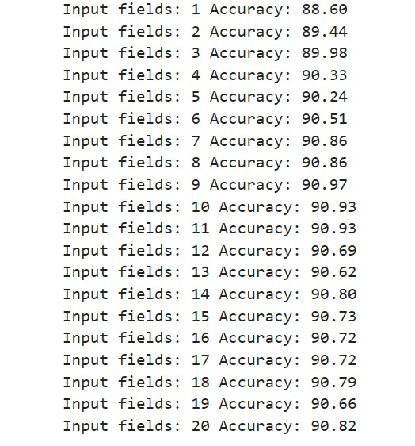

Slide 14
Conclusion
- Successfully classified client behavior using machine learning
- Feature importance varies by model
- Decision tree allows visual understanding of client segmentation
- Boosts marketing effectiveness
The project successfully classified client behavior using ML.
Feature importance varied across models, showing need for model-based tuning.
Decision tree helps in understanding customer segmentation visually.
The solution improves marketing effectiveness and targeting.

Slide 15
Future Scope
- Deploy as interactive dashboard for bank staff
- Integrate real-time data updates
- Add more client data: transactions, web behavior
- Explore deep learning models
Deploy as a web-based dashboard for bank marketers.
Add real-time updates using API-based customer data.
Include additional client attributes like transaction history.
Use advanced models like XGBoost, CatBoost, or neural networks.

Slide 16
References
- Moro, S., Cortez, P., & Rita, P. (2014). A Data-Driven Approach to Predict the Success of Bank Telemarketing
- UCI Repository: https://archive.ics.uci.edu/ml/datasets/Bank+Marketing
- Scikit-learn Documentation
- IBM AI Capstone Project
UCI Machine Learning Repository: https://archive.ics.uci.edu/ml/datasets/Bank+Marketing
Scikit-learn Documentation
GitHub Link: https://github.com/ChandanaS7/Client-Behavior-Classification.git

Slide 17
Thank you

